Slide 1
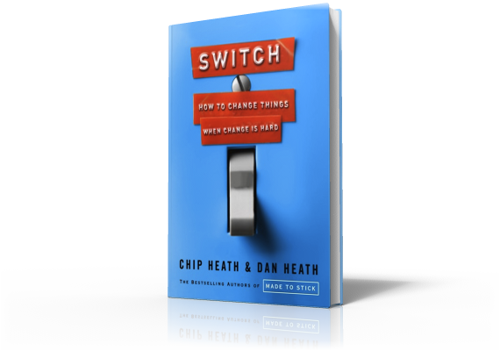
Switch
Direct The Rider:
Can Child Abusers Be Reformed?

Slide 2
Script the Critical Moves
Parent-Child Interaction Therapy
Notes:
We have seen examples how giving specific instructions can make a change effort successful, but how far does this theory go? What if we subject it to the toughest possible test? If we script the critical moves, can we change child abusers?
A study of child abusers was conducted in 2004. 73% had assaulted their children and 20% had assaulted them violently enough to have caused broken bones and severe lacerations.
The parents blamed the children for the abusive behavior, believing they needed to discipline their children because the children wouldn't listen. The parents believed they had gotten a bad kid and violence was the only way to get them to obey.
To stop their abuse, a form of therapy was used called Parent-Child Interaction Therapy or PCIT. It starts with an assignment: a parent is asked to play with their child for five minutes a day. The parent must devote 100% of their attention to the child during these five minutes.

Slide 3
Script the Critical Moves
Parent-Child Interaction Therapy
Notes:
At first, the play sessions are conducted in a laboratory setting. The parent and child sit in an empty room with only a table and chairs. Three or four toys are put on the table. The parent is told to let the child lead the play session and to give no commands or criticism or even ask questions.

Slide 4
Script the Critical Moves
Parent-Child Interaction Therapy
Notes:
A therapist watches the play session from outside the room and coaches the parent over an earpiece.

Slide 5
Script the Critical Moves
Parent-Child Interaction Therapy
Notes:
A typical interaction goes like this: A parent and child might start coloring and the parent tries to participate by coloring on the child's paper. The child objects. So the therapist tells the parent: "Okay, get a separate piece of paper and imitate what your child is doing."
If the child is coloring a rainbow, the parent colors a rainbow too, saying "I'm coloring a rainbow just like you. You're using green, I'm going to use green." Some children might reach over and grab the parent's green crayon yelling, "I want that!" The therapist teaches the parent to say, "Okay, I'd be happy to share that crayon with you."
They get parents to bend a like a reed. Whatever the child is doing, the parent offers no resistance, so the child has nothing to fight against.

Slide 6
Script the Critical Moves
Parent-Child Interaction Therapy
Notes:
The parent is taught to praise the child's behavior. "I like how hard you're working. Good job. You're being very kind to that doll." The parent is also taught to describe the child's behavior so that the child feels noticed. "Oh look, now you're putting the car in the garage."

Slide 7
Script the Critical Moves
Parent-Child Interaction Therapy
Notes:
Eventually, after a parent has gotten better at these short interactions, a therapist teaches how to give a command combined with a reason so that the command doesn't feel arbitrary. "It's almost time for the bus, so please put your shoes on now."
In a study of 110 parents who had abused their children, half were assigned 12 sessions of PCIT and half were assigned the standard treatment of 12 sessions of anger management therapy. They were tracked for 3 years. 60% of those who received anger-management therapy abused again. Only 20% of those who received PCIT re-offended.
The success of PCIT intervention demonstrates the power of scripting the critical behaviors to bring about lasting change.

