Slide 1
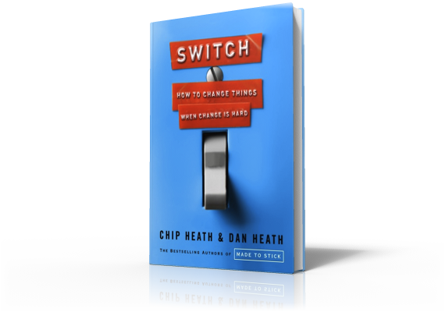
Switch
Direct The Rider:
The Danger of Vagueness

Slide 2
Script the Critical Moves
The Danger of Ambiguity
Notes:
When you want to script the critical moves, you can't assume those moves are obvious. You must explain the new behavior clearly. To see why, consider a campaign that is the opposite of 1% milk campaign in terms of its clarity. I'm referring to the U.S. government's Food Pyramid, the perfect example of how not to change people's behavior. What dooms the Food Pyramid could doom your efforts to create change. First is the pyramid shape, which typically signifies hierarchy, but there is no hierarchy intended in the food pyramid.

Slide 3
Script the Critical Moves
Decision Paralysis
Notes:
Originally, oils were at the top of the pyramid and some people thought that meant that oils were the most important food group.

Slide 4
Script the Critical Moves
The Danger of Ambiguity
Notes:
They then abandoned the hierarchical-looking structure for colorful streaks, but what do the streaks mean? If you look carefully, you might find out that the yellow streak is "oils".

Slide 5
Script the Critical Moves
The Danger of Ambiguity
Notes:
If you dig further, you may find a recommendation that adults consume 5 to 7 teaspoons of oil each day. How many teaspoons of oil did you consume today?

Slide 6
Script the Critical Moves
The Danger of Ambiguity
Notes:
The language and concepts are so abstracted from the everyday experience of food that the message both confuses and demoralizes.

Slide 7
Script the Critical Moves
The Danger of Ambiguity
Notes:
Compare this with the rule of thumb to get the oil in your car changed every 3 months or 3,000 miles. That clear and actionable. And that's the kind of actionable advice you need to give if you want to script the critical moves.

