Slide 1
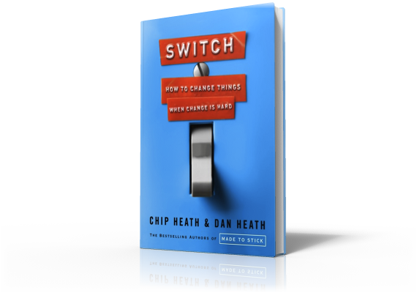
Switch
Direct The Rider:
Script The Critical Moves

Slide 2
Script the Critical Moves
Decision Paralysis
Notes:
In 1995, Brazil's railroads were privatized, splitting them into seven branches and selling them off piecemeal. At the time of auction, they were in a deteriorated state. A private firm bought the southern line, renamed itself America Latina Logistica (ALL), and put one of its executives, Alexandre Behring, in charge.

Slide 3
Script the Critical Moves
Decision Paralysis
Notes:
At the start, A.L.L. was so cash-strapped that Behring had to say no to a request to repair a single bridge. His top priority was get into a better financial state. He and his CFO developed four rules:
1. Unblock revenue.
2. Minimize up-front cash.
3. Faster is better than best.
4. Use what you've got.

Slide 4
Script the Critical Moves
Decision Paralysis
Notes:
This is how you script the critical moves. Behring moved the company in a new direction by providing crystal-clear guidance. He did it by thinking of the behavior he wanted to see in the tough moment. You can't script every move, so you focus on the critical moves.

Slide 5
Script the Critical Moves
Decision Paralysis
Notes:
Behring's four rules were for financial triage. In 1998 for instance, while competitors negotiated for new locomotives, ALL repaired old ones. Why? Rules 2 and 3. Minimize up-front cash and faster is better than best.

Slide 6
Script the Critical Moves
Decision Paralysis
Notes:
ALL boosted fuel capacity to operate longer without refueling. This allowed more routes per locomotive and, in accordance with rule 1, unblocked revenue.

Slide 7
Script the Critical Moves
Decision Paralysis
Notes:
To fix damaged tracks, ALL followed rule 4 to use what you've got and ripped up tracks at abandoned stations and installed them on active routes. They saved $400 per ton.
Three years later, ALL's performance improved from a net loss of 80 million reais to a net profit of 24 million reais.
Knowing what we know about the Rider, it should be no surprise that Behring's strategy worked - he scripted the critical moves that helped his people make the hard decisions.

