Slide 1
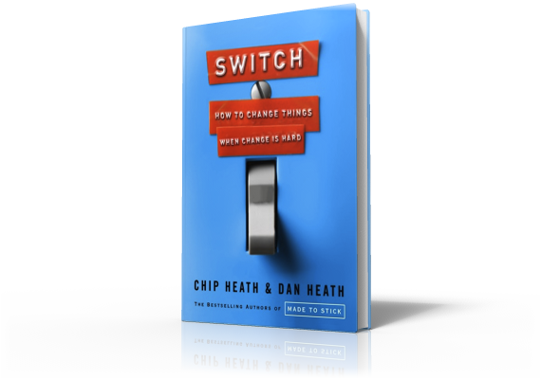
Switch
Direct The Rider:
The Paradox of Choice

Slide 2
Script the Critical Moves
Decision Paralysis
Notes:
A 67-year-old patient had chronic hip pain from arthritis. He had been given drugs to treat his pain, but they had been ineffective, …

Slide 3
Script the Critical Moves
Decision Paralysis
Notes:
… so his doctor had to consider hip-replacement surgery. This is a complex surgery and recovery is long and painful.

Slide 4
Script the Critical Moves
Decision Paralysis
Notes:
But then, a final check with the patient's pharmacy revealed a medication that hadn't been tried. So, now the doctor had a choice: prescribe the untried medication or refer the patient for surgery. 47% of doctors chose the medication.
In a variation, doctors were presented with the same facts, but with two untried medications. This is great, you have two medications to try, but guess what happened! Only 28% chose to try either one.
What happened here was decision paralysis. The more options we have, the more likely we are to retreat to the default plan.

Slide 5
Script the Critical Moves
Decision Paralysis
Notes:
It happens all the time. At a gourmet food store, managers set up a table where customers could sample imported jams. One day, six jams are displayed. Another day, 24 jams. Shoppers who saw the 6 jam display are 10 times more likely to buy than those who saw the 24 jam display.

Slide 6
Script the Critical Moves
Decision Paralysis
Notes:
In retirement planning, you lose 2% of the people for every ten mutual fund options you offer, even when deferring means that the people lose out on employer-matched contributions.

Slide 7
Script the Critical Moves
Decision Paralysis
Notes:
The status quo feels comfortable because choice has been removed. You have a routine. The Rider is on autopilot. In times of change, autopilot doesn't work. Say you start a diet. Your daily trip for nachos is now disqualified, so in its place is a decision. What am I going to eat?
Change brings new choices that create uncertainty. You don't always know what options are available. This uncertainty leads to paralysis just as easily as having too many choices.
This exhausts the Rider, and the Elephant ends up taking the more familiar path. This makes decision paralysis deadly for change - because the most familiar path is the status quo.
Any successful change effort requires that ambiguous goals become concrete behaviors. You need to script the critical moves.

