Slide 1
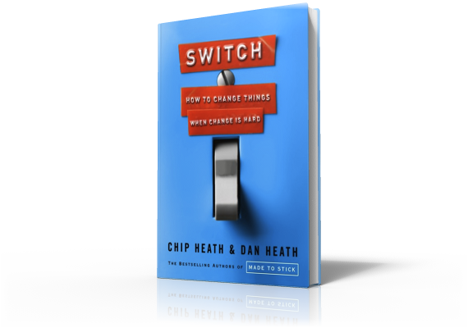
Switch
3 Surprises About Change:
Resistance vs. Lack of Clarity

Slide 2
Three Surprises About Change
Notes:
Jon Stegner believed his company was wasting money due to poor purchasing habits. He had an intern investigate just one item the company purchased: work gloves, which most of the company's workers wore. The intern reported that not only did the company purchase 424 distinct kinds of work gloves, but the company was using different suppliers as well, each negotiating a different price.
A glove that cost $5 at one factory might cost $17 at another.

Slide 3
Three Surprises About Change
Notes:
Most people at this point would have made a well-reasoned case for changing purchasing habits complete with spreadsheets, data, and recommendations. Such an appeal might have gotten some supportive nods and an agreement to overhaul the purchasing system at some point in the future. This kind of thing speaks to our Riders.
But instead, Stegner had the intern gather a specimen of each type of glove, tag it with the price paid, and then he piled them on the boardroom conference table and invited all the division presidents to look. They had a visceral reaction to the glove shrine and Stegner got the mandate for the change he was looking for. He was speaking to the division presidents' Elephants.

Slide 4
Three Surprises About Change
Notes:
Two West Virginia University health researchers wanted to persuade Americans to eat healthier. They knew that a message of "eat a healthier diet" was vague. It left open all kinds of questions. Which foods do you stop or start eating? Should eating behavior change at breakfast?

Slide 5
Three Surprises About Change
Notes:
At lunch?

Slide 6
Three Surprises About Change
Notes:
At dinner? The number of ways to eat healthier is limitless, which means our Riders will get stuck in analysis paralysis.

Slide 7
Three Surprises About Change
Notes:
So the researchers got specific. They knew that milk was the largest source of saturated fat in the American diet and they knew that if Americans switched to 1% milk, the average diet would immediately attain the USDA recommended level of saturated fat.
So how do you get Americans to starting drinking 1% milk?

Slide 8
Three Surprises About Change
Notes:
You make sure it shows up in their refrigerators. You don't need to change drinking behavior directly. You just need to change purchasing behavior and drinking behavior will follow.

Slide 9
Three Surprises About Change
Notes:
So the researchers ran spots on local media in two West Virginia communities. These ads talked about how a glass of whole milk has the same saturated fat as five strips of bacon. Next, they monitored milk sales data in the intervention area. Market share of low fat milk went from 18% to 41% during the campaign and held steady at 35% six months later.
Before this study, you might have thought these West Virginians just didn't care about their health. But by giving them a clear action to take, the researchers changed their habits. This illustrates a critical component in successful change efforts: the need to provide crystal clear direction. And that's because of the third surprise about change: What looks like resistance is often a lack of clarity.

