Slide 1
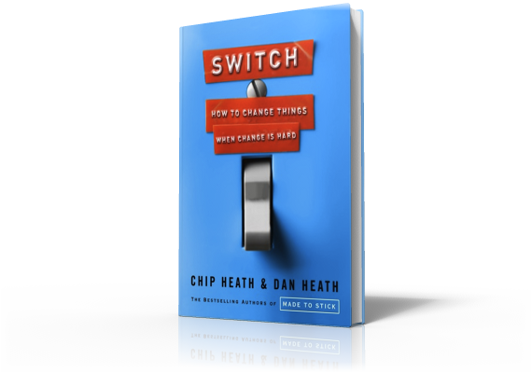
Switch
3 Surprises About Change:
People vs. Situation Problems

Slide 2
Three Surprises About Change
Notes:
At a movie theater in suburban Chicago in 2000, some unsuspecting moviegoers showed up to watch a matinee of Mel Gibson's Payback.

Slide 3
Three Surprises About Change
Notes:
They received a free soft drink and a free bucket of popcorn. They were asked to stay after the movie to complete a survey about the concession stand. But they were actually part of a study of irrational eating behavior.
There was something special about the popcorn. It was wretched. And this was deliberate. It had been popped 5 days earlier so that it would be so stale that it would squeak when you ate it.
At random, people were given either a medium sized bucket or a large. Everybody got a bucket to make sharing unnecessary. Both buckets were so big that none of the moviegoers could finish their portions. The researchers wanted to know: Would someone with a larger inexhaustible supply of popcorn eat more than someone with a smaller inexhaustible supply?
By weighing the buckets before and after, the researchers know how much each person ate. The results were surprising: People with the larger bucket at 33 percent more popcorn.

Slide 4
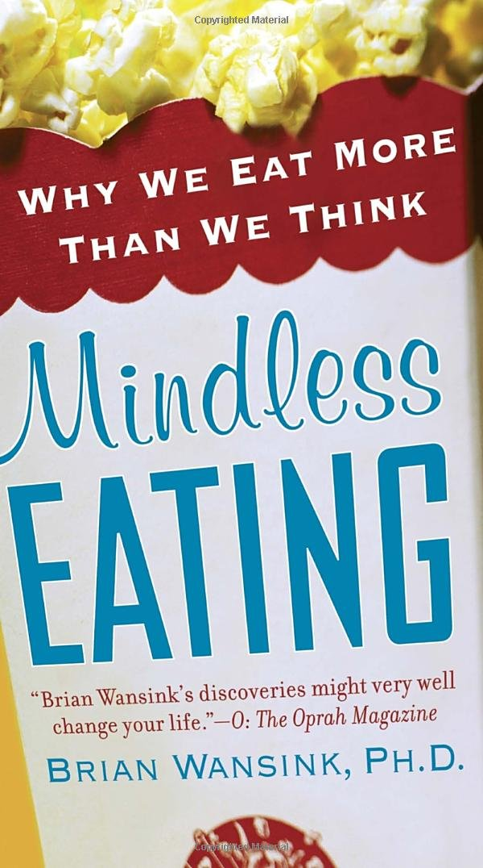
Three Surprises About Change
Notes:
Brian Wansink authored the study and described his results in his book Mindless Eating.
It was the size of the container that determined how much was eaten. No other theory explains the behavior. The people weren't eating for pleasure. They weren't driven by a desire to finish their bucket. Both buckets were too big to finish. And it didn't matter whether they were hungry of full.
Imagine that someone showed you the data from the popcorn study. You would likely think that some people are moderate snackers and others are gluttons. Public health experts would get concerned about the gluttons and would likely want to motivate the gluttons to adopt healthier habits.

Slide 5
Three Surprises About Change
Notes:
But, if you want people to eat less popcorn, the solution is simple…

Slide 6
Three Surprises About Change
Notes:
…give them smaller buckets.

Slide 7
Three Surprises About Change
Surprise 1: What looks like a people problem is often a situation problem
Notes:
And that’s the first surprise about change: What looks like a people problem is often a situation problem.

